Slide 1
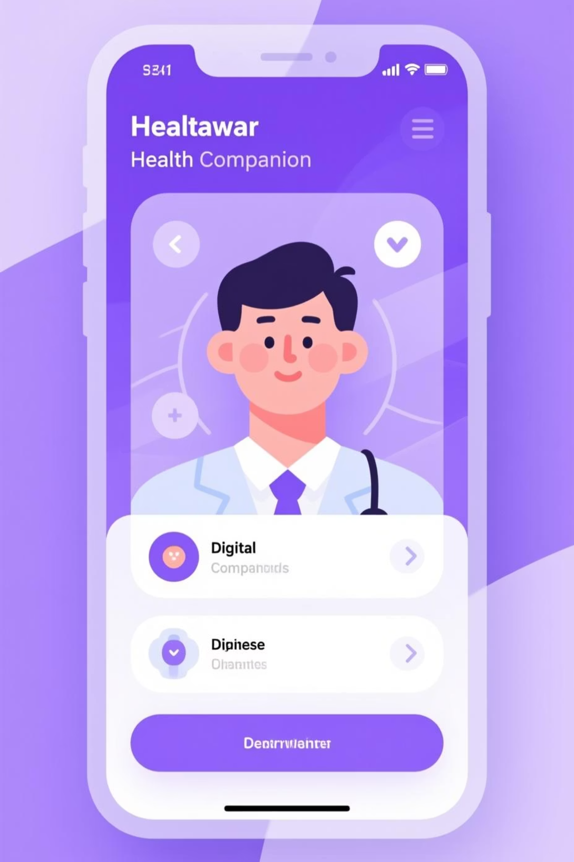
HealthMate: Your AI-Powered Symptom Companion
HealthMate is a revolutionary Generative AI–powered chatbot designed to be a safe and empathetic first-level companion for interpreting mild health symptoms. We provide trustworthy guidance to reduce misinformation and encourage timely professional consultation.

Slide 2
The Challenge
The Digital Health Gap
Delayed Consultation
Misinformation & Panic
Lack of Trust
People often postpone seeing a doctor for minor, yet persistent, symptoms like fatigue or mild fever.
Unfiltered online symptom searches frequently lead to inaccurate, fearful, and often harmful self-diagnoses.
The public needs an accessible, trustworthy, and empathetic digital assistant for basic health awareness and guidance.

Slide 3
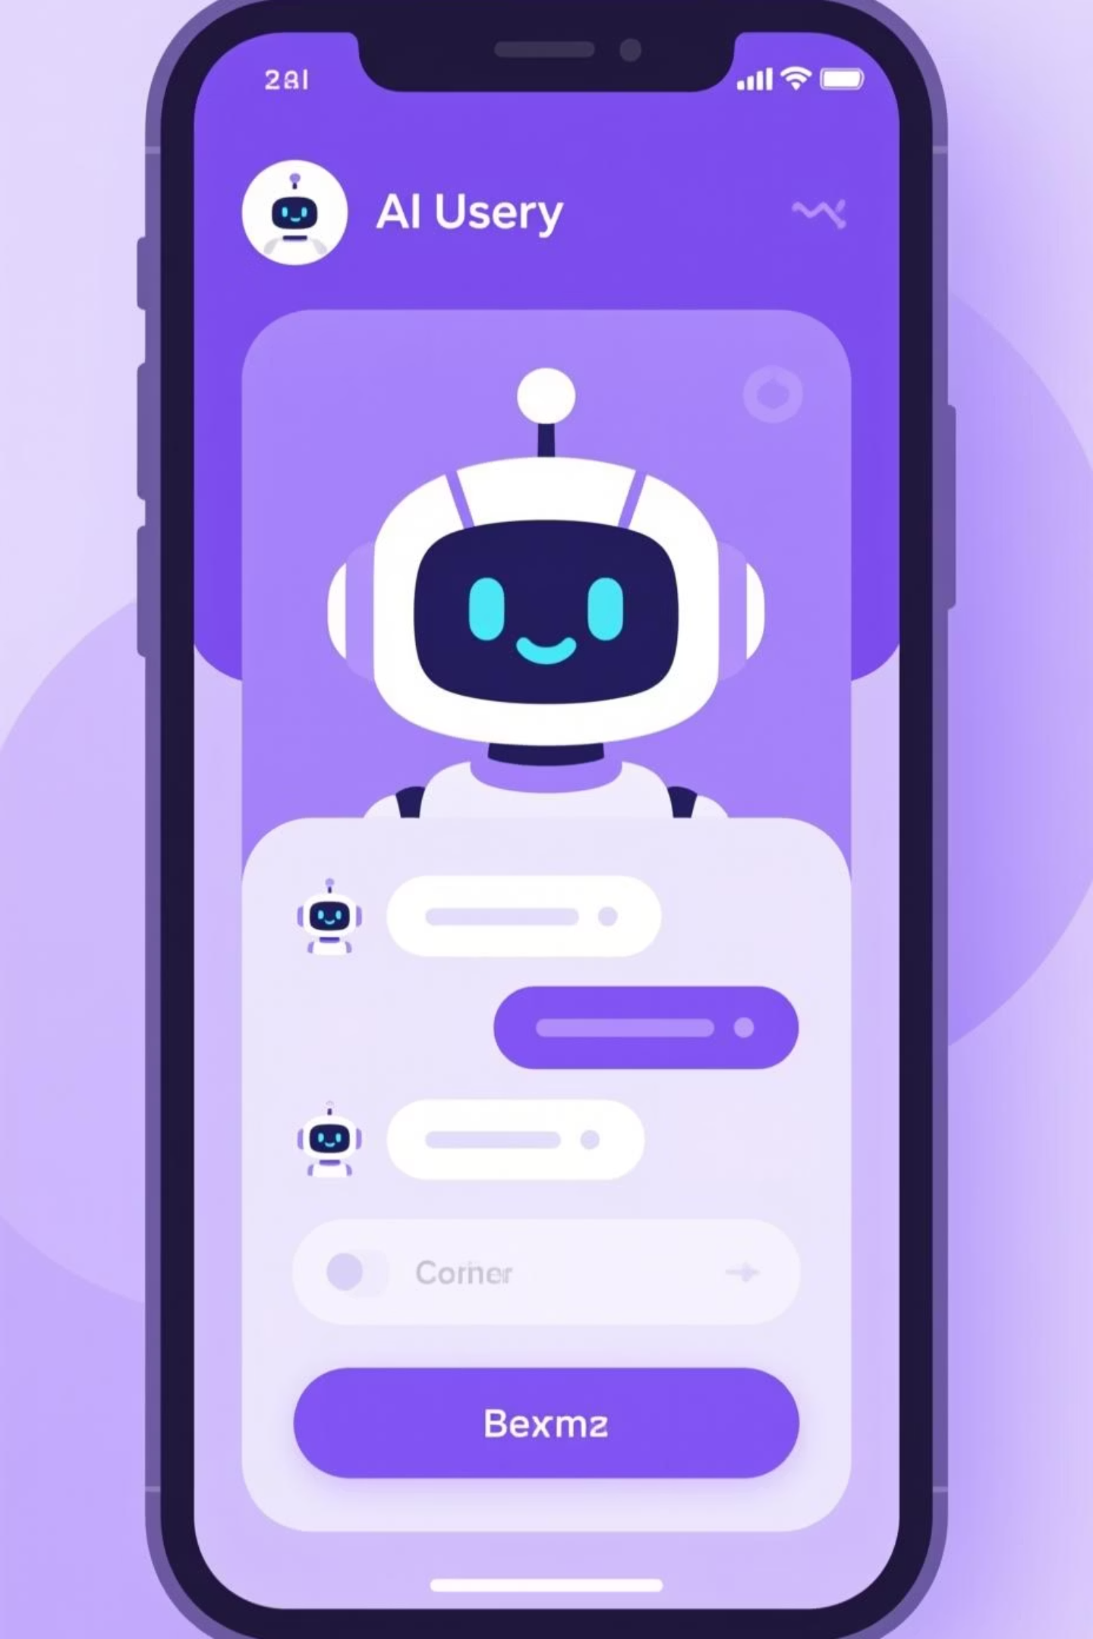

The HealthMate Solution
HealthMate is a Generative AI companion that responsibly interprets user symptoms, providing educational guidance—not a diagnosis.
1
2
Interpret Symptoms
Provide Guidance
Analyzes input (text, voice, or image) to understand the user's situation.
Offers structured, easy-to-understand explanations of possible causes and safe self-care tips.
3
Triage & Alert
Instantly detects emergency keywords and prompts the user to seek immediate professional help.

Slide 4

Core Features: Structured & Empathetic Responses
Versatile Input
Accepts text or voice descriptions of symptoms, plus optional image uploads (e.g., rashes or swelling).
Clear Structure
Responses are organized into three clear sections: Possible Causes, Safe Self-Care Tips, and a clear "When to See a Doctor" recommendation.
Multilingual Support
Initially supports English and Hindi to serve a broad audience.
Safety First
Our AI is trained to deliver empathetic communication, ensuring explanations are user-friendly and supportive.
Built-in emergency detection for critical keywords (like "chest pain" or "fainting") triggers immediate alerts.

Slide 5

Technical Foundation: Powered by Google AI
HealthMate leverages the robust, scalable tools within the Google ecosystem for reliable performance and advanced intelligence.
AI & ML
Backend
Scalable Hosting
Utilizes Google Gemini Pro API for sophisticated text and image understanding, plus Vertex AI for context management.
A stable Python Flask API handles user requests and routes information securely through the system.
Deployed on Google Cloud Run or Render for high availability and scalable performance under growing user demand.

Slide 6
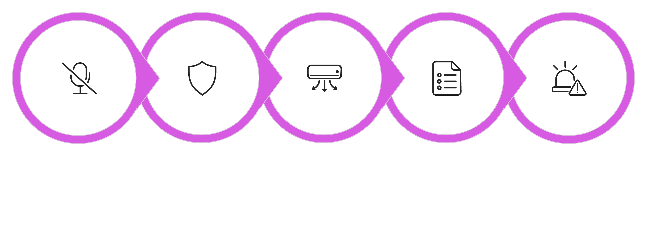
HealthMate Workflow: From Symptom to Guidance
Describe Symptoms
Secure Processing
Structured Response
Emergency Check
Analyze Data
This process ensures rapid, accurate analysis and prioritizes user safety by immediately escalating detected emergencies.

Slide 7


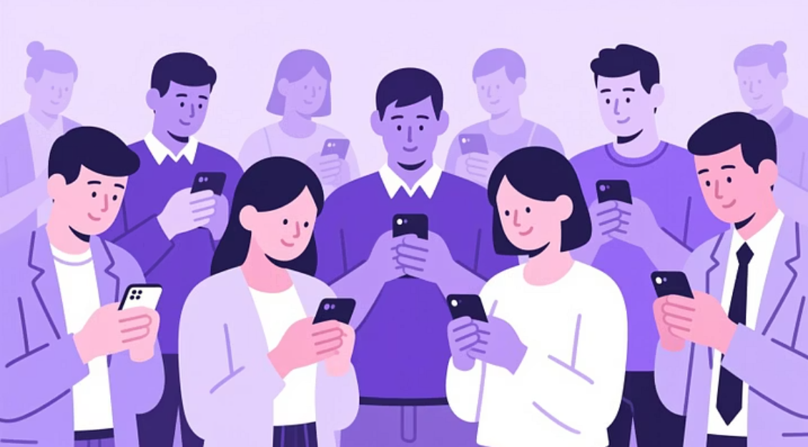
Target Users: Who Benefits from HealthMate?
Students
Families
General Public
For quick, reliable understanding of common issues like stress, minor injuries, or seasonal sickness.
For initial interpretation of symptoms affecting children or elderly relatives before deciding on next steps.
Anyone seeking trustworthy, easy-to-understand first-level health awareness guidance.

Slide 8

Expected Impact: Redefining Health Access
Boost Health Awareness
Increases digital health literacy and reduces the spread of online misinformation.
Encourage Early Care
Promotes timely and appropriate medical consultation, improving health outcomes.
Serve Underserved Areas
Offers accessible, high-quality basic health guidance in rural or communities with limited access to primary care.
Responsible AI
Demonstrates the positive, responsible application of Generative AI in the sensitive healthcare domain.

Slide 9
Future Enhancements: A Holistic Health Companion
Wearable Integration
Connect with devices to incorporate vital signs (heart rate, temperature) into symptom analysis.
Personalized Tracking
Develop a dashboard for users to track personal health trends and recurring symptoms.
Expanded Multilingualism
Add support for regional Indian languages to maximize accessibility.
Professional Network
Integrate a doctor network for seamless online consultations directly following triage.

Slide 10


Conclusion: Bridging the Gap
HealthMate empowers users to make informed first-level health decisions through the power of Google's Generative AI and human-centric design.
Our Mission
To bridge the critical gap between confusing self-diagnosis and necessary professional healthcare by providing safe, educational, and timely guidance.

